Slide 1
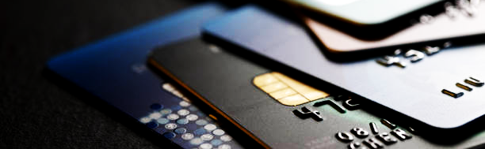
BetterSwipe
CS411 Spring 2024
Prototype Demo #2
Team Blue Team Members: Marcelo Vargas, Cody Cochran, Rich Connor, Christian Euell, Albert Ayitey-Adjin, John Cartwright, Ben Paul

Slide 2
The planning approach (How is this going to get done?)
Front-end: Richard, Albert, Marcelo and Christian will collaboratively engage in the initial configuration of the BetterSwipe application, focusing on critical components such as Login/registration, Home, Dashboard, and Card Composition. This endeavor will be executed leveraging the capabilities of React.js, a powerful and widely used JavaScript library for building user interfaces.
Back-end: Cody, Ben, Marcelo, and John will be working on the Expense Profile,

Slide 3








Implementation Tools
Front-End | React
Back-End | Django
Database | Microsoft SQL Server
Deployment Environment | Docker
Version Control/Repository | GitHub
File Sharing | Google Cloud
Project Management/Sprint Plan | Trello

Slide 4

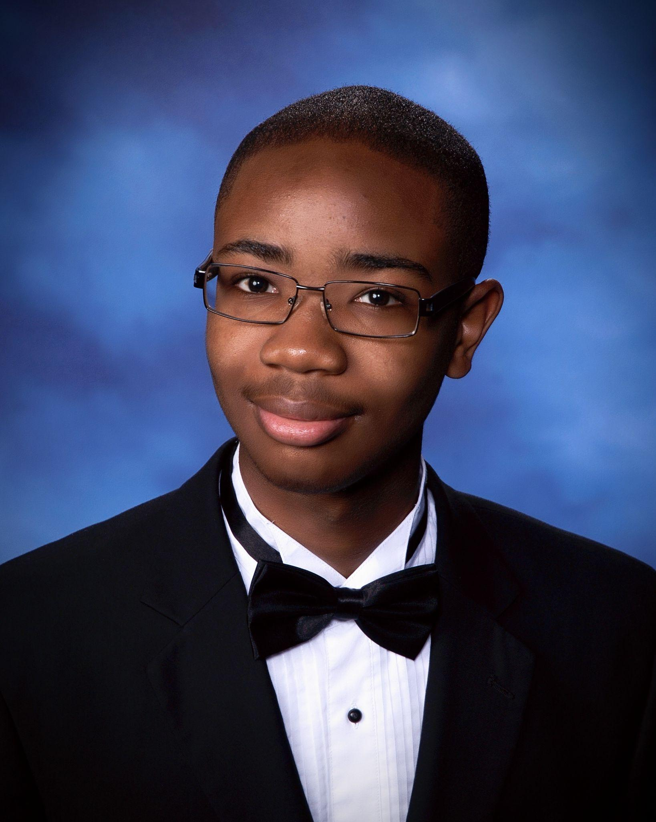


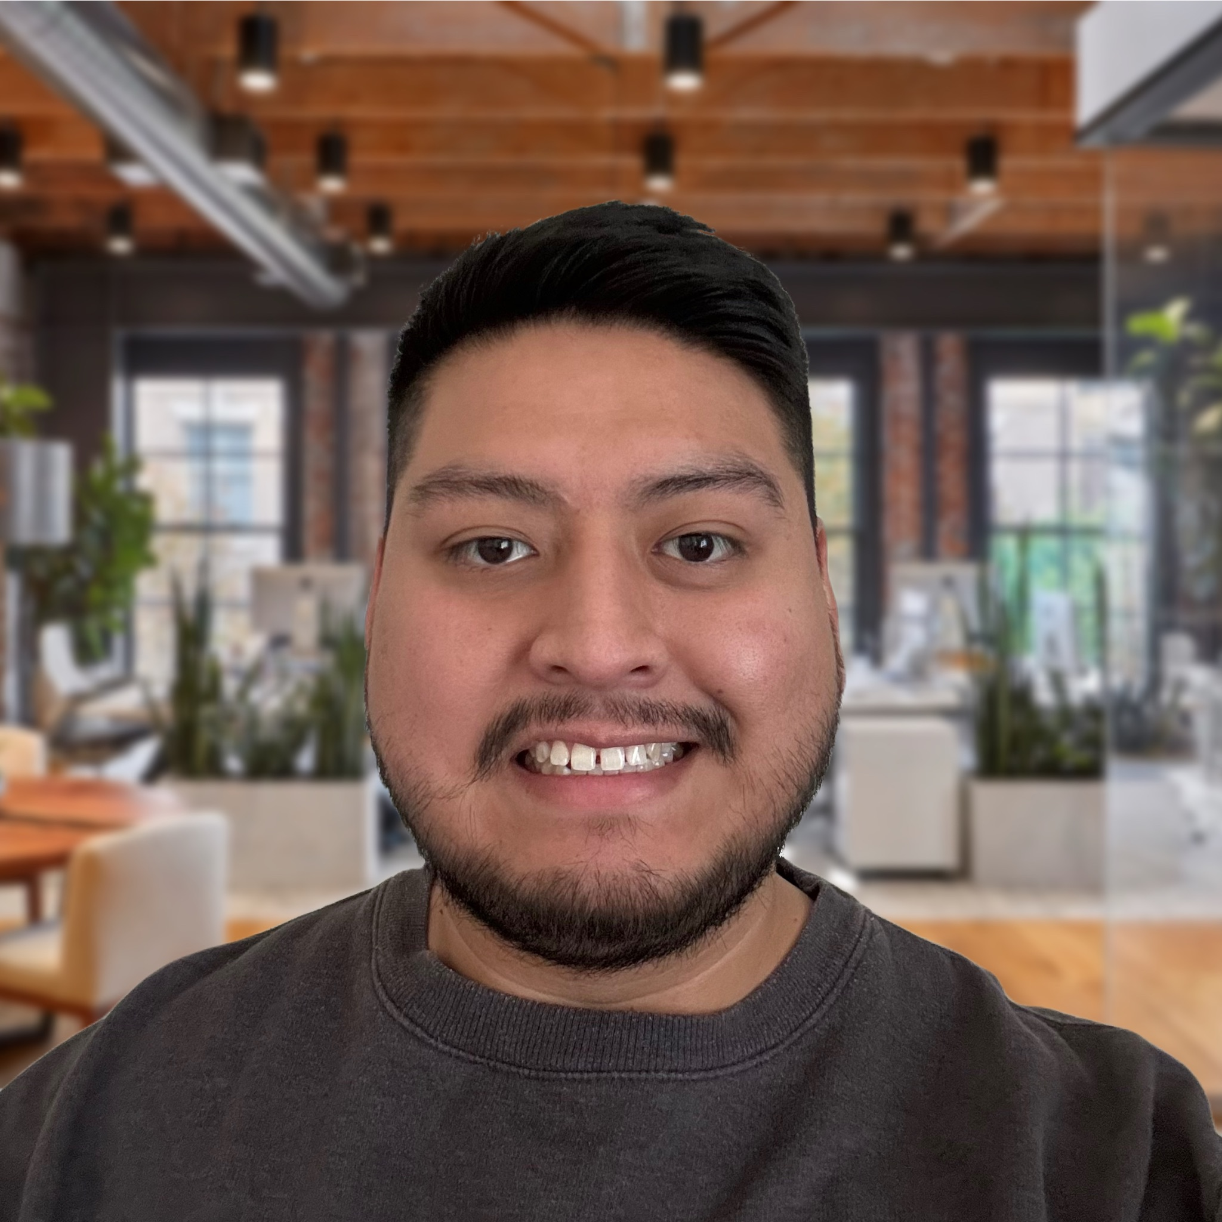

Team Roles and Responsibilities | Albert Front end Card Comparison Navigation bar
Ben | Christian Front end Documentation Specialist Login/Registration
Cody Back end / Algorithms Statement Upload Card Recommendations | John Back End Expense Profile
Marcelo Full Stack Developer Database Engineer | Richard Front end Home/Dashboard

Slide 5
Sprint/Task Breakout/Schedule Timeline (Gantt)
Sprint 0 (weeks 1-4)
Establish development environment
Account Roles/Authentication
DB Design
UI Scaffolding
Sprint 2 (weeks 8-10)
homepage/login/signup
Integrate upload page
Database integration for accounts
Sprint 4 (weeks 14-16)
Final integration
Full functional testing
Sprint 1 (weeks 5-7)
UI .csv. File Upload
Backend integration for file upload
DB refinement
Sprint 3 (weeks 11-13)
Dashboard/Card Comparison UI
Algorithms to process data and provide recommendations
Continued integration and testing

Slide 6
User Stories ⇔ Feature mapping
Feature | User Story
General
Web and Mobile Interfaces | As a user, I would like an adaptive interface that can fit to the size of my screen
Account Registration | As a user, I would like to have my own account As a user, I would like to be able to name my account As a user, I would like to be able to create a password of my choosing
Authentication | As a user, I would like my account to be locked unless I type in the password previously established with my account.
Profile CRUD | As a user I would like to be able to make changes to my account settings.
History of Reports | As a user, I would like to see my past transactions As a user, I would like to see my rewards history
Security
Data-at-Rest encryption | As a user, I would like my personal and banking information to be secure when it is stored.
Data-in-Transit encryption | As a user, I would like my personal and banking information to be secure when it is in transit.
Statement Analysis
Statement Upload | As a user, I would like to be able to upload my bank statement so I don’t have to type in all of my purchases by hand. As a user, I would like to be able to periodically upload more statements after the initial use.
Expenditure Categorization | As a user, I would like to be able to see all my transactions categorized.
Expenses Summary | As a user, I would like to see a summary of how much I have been spending in each category.
Reward Card Features
Card Recommendations | As a user, I would like for recommendations to be personalized to match my necessities and spending history. As a user, I would like updated recommendations of rewards cards based on my updated bank statements.
Card Comparisons | As a user, I would like to be able to see the top 3 recommended cards compared side-by-side, so I have alternate options if I don’t like the top recommendation.
Rewards Card Details | As a user, I want to be able to see information about the rewards cards, such as APR and specifics about the rewards offered.
Continuous Monitoring
Saving Prediction | As a user, I would like to receive a general summary of how much I would earn if I used a selected rewards credit card.
Future Purchase Recommendations | As a user, I would like to be able to add information about future purchases so that they will be considered with savings predictions. As a user, I would like to receive reminders of rewards that I have and where I can apply them with purchases I am already making.

Slide 7
Prototype Changes/Adjustments
Simulation of RewardsCC API data

Slide 8
In-Process Developments
Simulation of RewardsCC API data
Login/Registration Process
NavBar configuration
Database integration

Slide 9
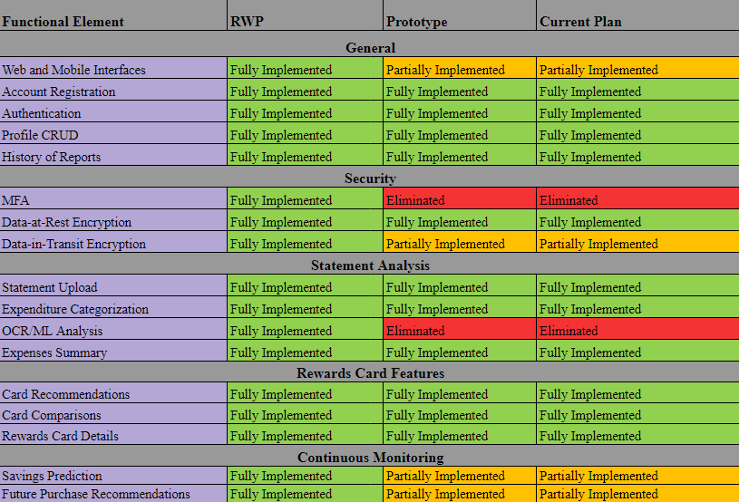
RWP=>Original Prototype=>Current Plan Features table
Functional Element | Real World Product (RWP) | Prototype | Current Plan | Reason
Login/Register | Full Functionality | Full Functionality
Feature encryption | Full Functionality | Full Functionality
Statement Upload | Full Functionality | Partial Functionality |  | Only accepts Excel-compatible format
Categorization of expenditures | Full Functionality | Partial Functionality |  | Combination of ML and adjustments
Download rewards details for credit cards cards | Full Functionality | Partial Functionality |  | Stimulating data from a real database baseline
Expenditure Profile Creation/Maintenance | Full Functionality | Full Functionality
Card Recommendations/Comparisons | Full Functionality | Full Functionality
Continuous Monitoring of expenditures/cards | Full Functionality | Partial Functionality |  | Using simulated data
Continuous Monitoring of expenditures/cards | Full Functionality | Full Functionality

Slide 10
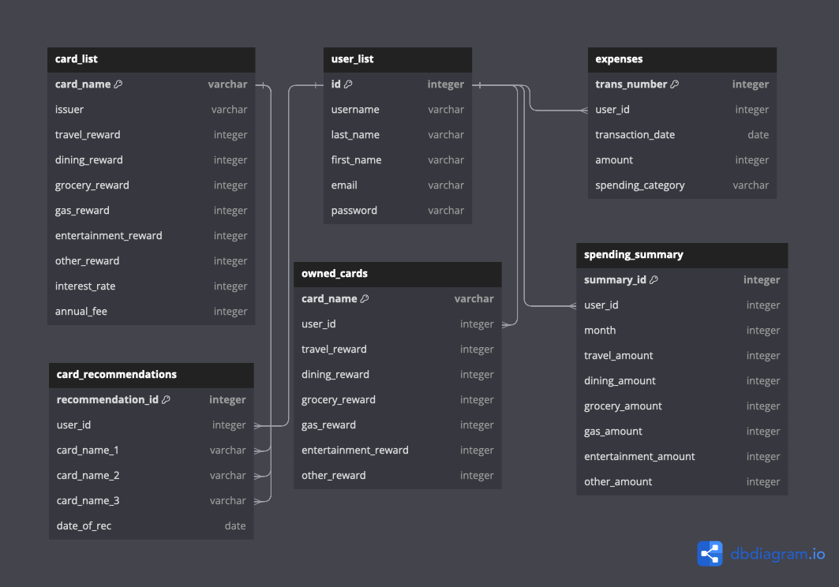
Database Implementation Concept (Structure/Approach)

Slide 11
Integration/Testing Approach
Simulation of RewardsCC API data
Web Application responsiveness speed
Successful account creation and login
Potential cyber threats

Slide 12
User stories with changes identified
As a user, I would like an adaptive interface that can fit to the size of my screen
As a user, I would like to have my own account
As a user, I would like to be able to name my account
As a user, I would like to be able to create a password of my choosing
As a user, I would like my account to be locked unless I type in the password previously established with my account
As a user I would like to be able to make changes to my account settings.
As a user, I would like to see my past transactions and rewards history
As a user, I would like to see my past transactions and rewards history
As a user, I would like to see a history of my past results.
As a user, I would like my personal and banking information to be secure transmitted and stored when it is stored.
As a user, I would like my personal and banking information to be secure transmitted and stored when it is in transit.
As a user, I would like to be able to scan upload my bank statement so I don’t have to type in all of my purchases by hand.
As a user, I would like to be able to periodically upload more statements after the initial use.
As a user, I would like to be able to see all my transactions categorized.
As a user, I would like to see a summary of how much I have been spending in each category.
As a user, I would like for recommendations to be personalized to match my necessities and spending history.
As a user, I would like constant updated recommendations of rewards cards based on my constantly updated bank statements.
As a user, I would like to be able to see the top 3 recommended cards compared side-by-side, so I have alternate options if I don’t like the top recommendation.
As a user, I want to be able to see information about the rewards cards, such as APR and specifics about the rewards offered.
As a user, I would like to receive a general summary of how much I would earn if I selected one of the suggested cards used a selected rewards credit card.
As a user, I would like to be able to add information about future purchases so that they will be considered with savings predictions.
As a user, I would like to receive reminders of rewards that I have and where I can apply them with purchases I am already making.

Slide 13
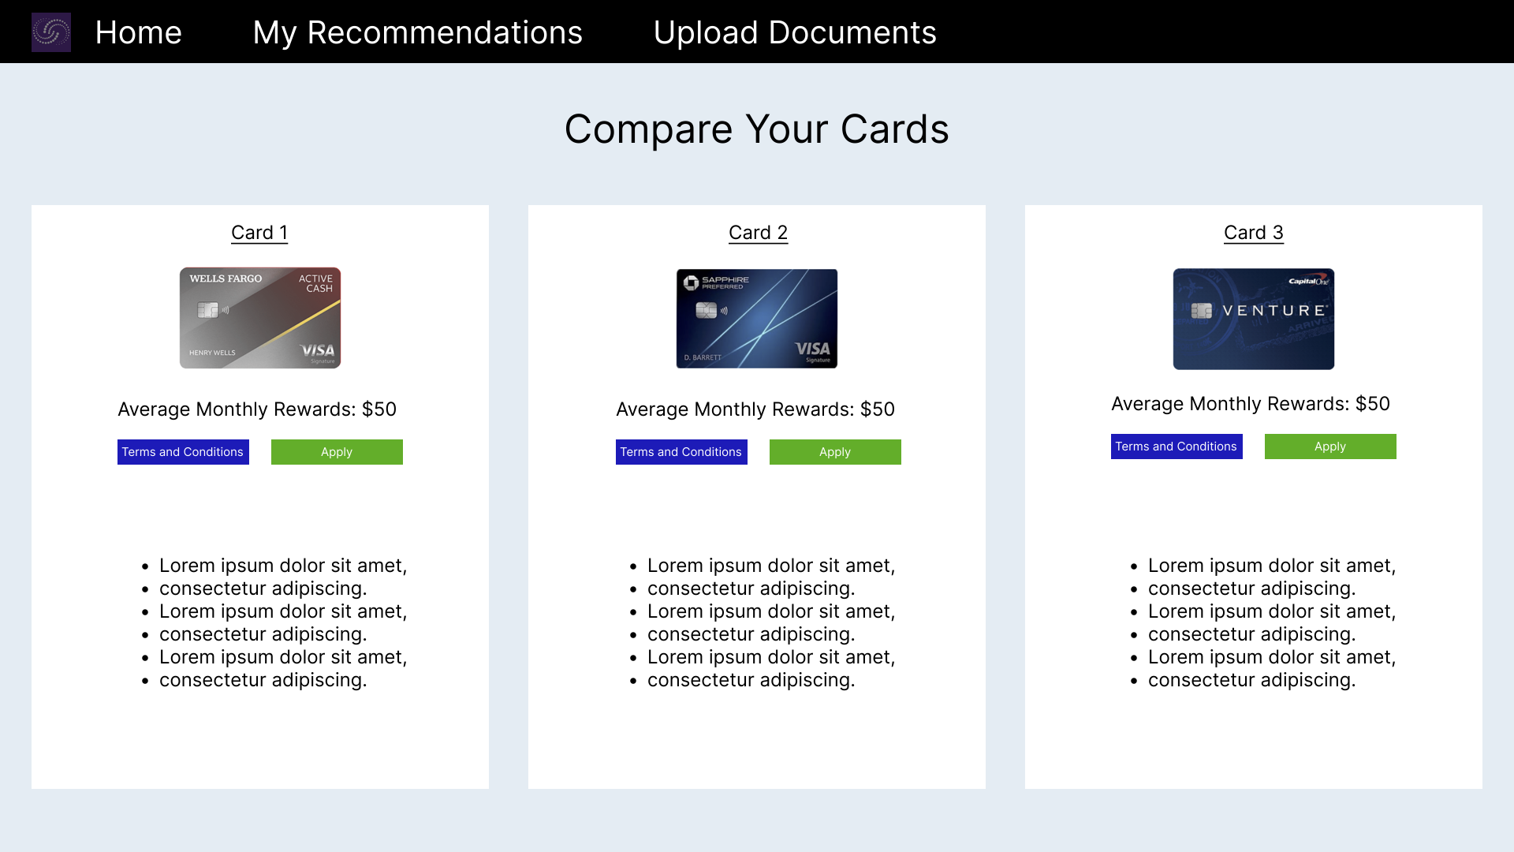
UI Mockup review

Slide 14
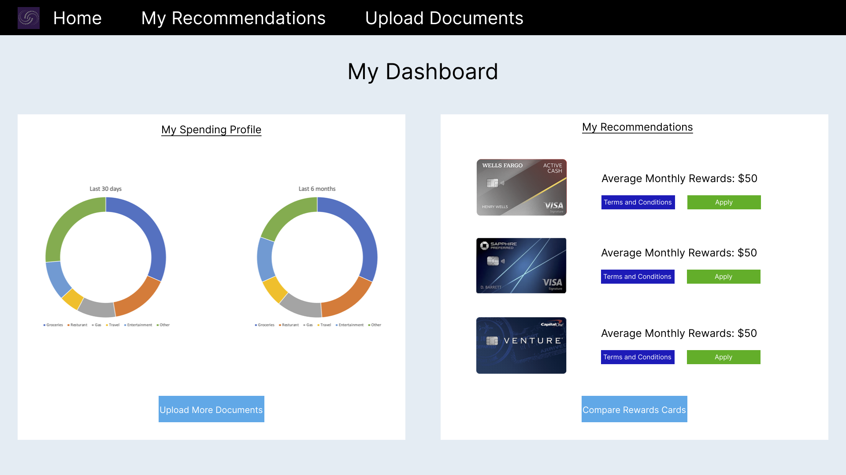
Dashboard: RWP

Slide 15
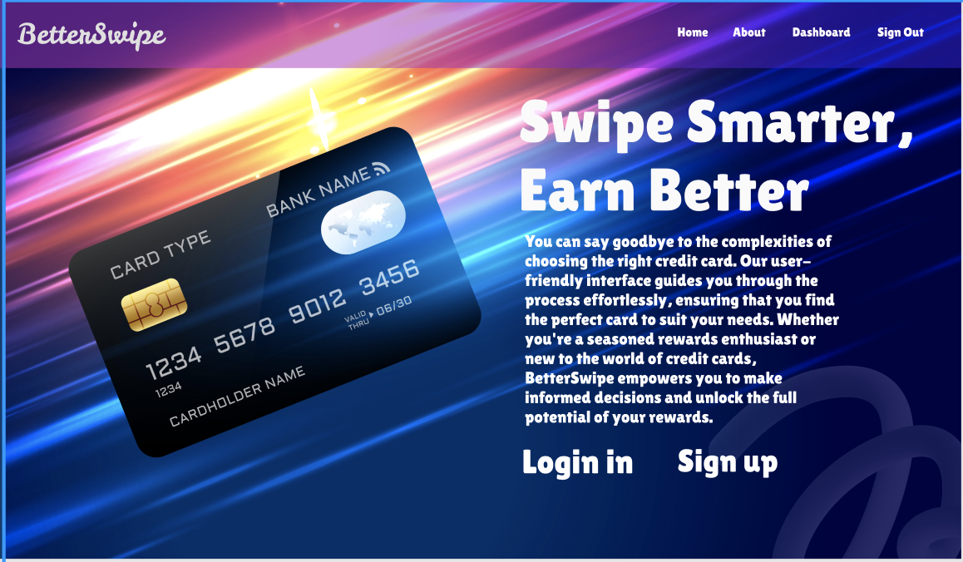
Mockup: Landing Page

Slide 16
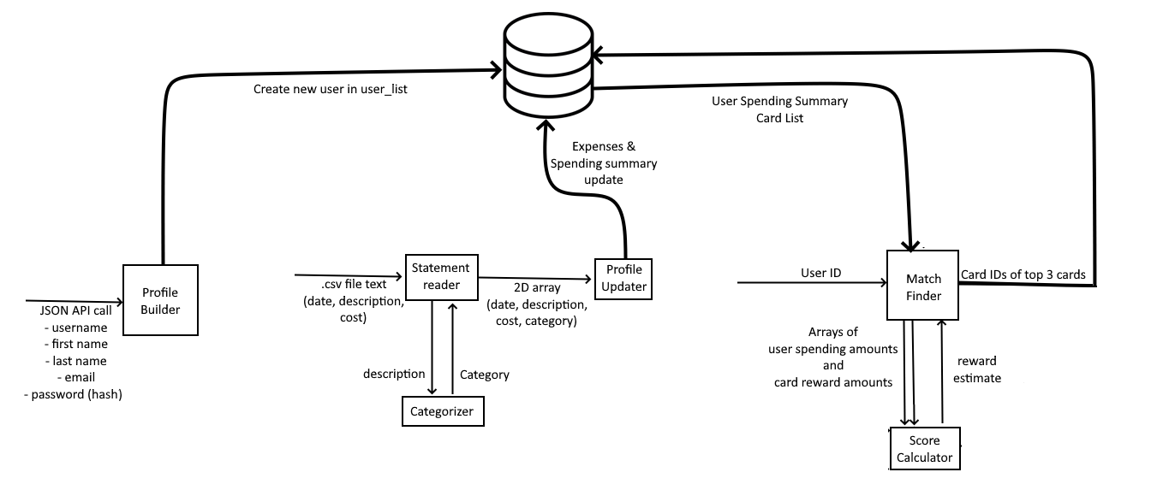
Algorithms Functional Breakdown

Slide 17
Near-Term Priorities
Full back-end/front-end communication
Algorithm development
UI design and optimization

Slide 18
Issues/Concerns/Challenges/Risks
Team collaboration and timing
Docker deployment
Full communication between frontend and backend

